Slide 1

HOW TO RETRIEVE DATA FROM RELATED TABLES IN DATATABLES Editor WITH ASP.NET 6
By Jordan Nash

Slide 2
Big SHOUT OUT TO…
Jade Gorton.
Hayden Kliese.
Herman Starzhynski.

Slide 3
Are You tired of writing code to sort, search and paginate data?
public async Task<IActionResult> Index(string sortOrder)
{
ViewData["NameSortParm"] = String.IsNullOrEmpty(sortOrder) ? "name_desc" : "";
ViewData["DateSortParm"] = sortOrder == "Date" ? "date_desc" : "Date";
var students = from s in _context.Students
select s;
switch (sortOrder)
{
case "name_desc":
students = students.OrderByDescending(s => s.LastName);
break;
case "Date":
students = students.OrderBy(s => s.EnrollmentDate);
break;
case "date_desc":
students = students.OrderByDescending(s => s.EnrollmentDate);
break;
default:
students = students.OrderBy(s => s.LastName);
break;
}
return View(await students.AsNoTracking().ToListAsync());
}
Regardless of the framework I have seen examples online of people using really outdated examples of how to do this.
There is more code on both the client and server.
There is less interactivity.
Here’s an example from Microsoft in C# and Entity Framework.

Slide 4
Here’s what it looks like in the front end.
@model IEnumerable<ContosoUniversity.Models.Student>
@{
ViewData["Title"] = "Index";
}
<h2>Index</h2>
<p>
<a asp-action="Create">Create New</a>
</p>
<table class="table">
<thead>
<tr>
<th>
<a asp-action="Index" asp-route-sortOrder="@ViewData["NameSortParm"]">@Html.DisplayNameFor(model => model.LastName)</a>
</th>
<th>
@Html.DisplayNameFor(model => model.FirstMidName)
</th>
<th>
<a asp-action="Index" asp-route-sortOrder="@ViewData["DateSortParm"]">@Html.DisplayNameFor(model => model.EnrollmentDate)</a>
</th>
<th></th>
</tr>
</thead>
Here’s an example from Microsoft’s ASP.NET CORE.
And that’s only showing the <head> tags of the page.

Slide 5
And that was just the head here’s the body.
<tbody>
@foreach (var item in Model) {
<tr>
<td>
@Html.DisplayFor(modelItem => item.LastName)
</td>
<td>
@Html.DisplayFor(modelItem => item.FirstMidName)
</td>
<td>
@Html.DisplayFor(modelItem => item.EnrollmentDate)
</td>
<td>
<a asp-action="Edit" asp-route-id="@item.ID">Edit</a> |
<a asp-action="Details" asp-route-id="@item.ID">Details</a> |
<a asp-action="Delete" asp-route-id="@item.ID">Delete</a>
</td>
</tr>
}
</tbody>
</table>
All this just to stop us from breaking dependency with ASP.NET Core
All this is going to do is sort, search and go to the next and previous pages.

Slide 6
Here’s all the dirty breadcrumbs under the body.
@{
var prevDisabled = !Model.HasPreviousPage ? "disabled" : "";
var nextDisabled = !Model.HasNextPage ? "disabled" : "";
}
<a asp-action="Index"
asp-route-sortOrder="@ViewData["CurrentSort"]"
asp-route-pageNumber="@(Model.PageIndex - 1)"
asp-route-currentFilter="@ViewData["CurrentFilter"]"
class="btn btn-default @prevDisabled">
Previous
</a>
<a asp-action="Index"
asp-route-sortOrder="@ViewData["CurrentSort"]"
asp-route-pageNumber="@(Model.PageIndex + 1)"
asp-route-currentFilter="@ViewData["CurrentFilter"]"
class="btn btn-default @nextDisabled">
Next
</a>
This code allows us to go 1 page forward and back between pages.

Slide 7
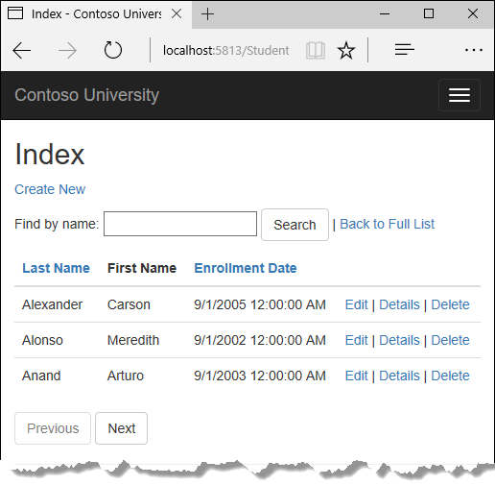
This is what it looks like when compiled in the browser.
I will give you 10 seconds to work out what features could be added in this picture on the right. What could they be?
Telling us the number of records in the table.
How many records to display at once.
Showing us many pages exist.

Slide 8
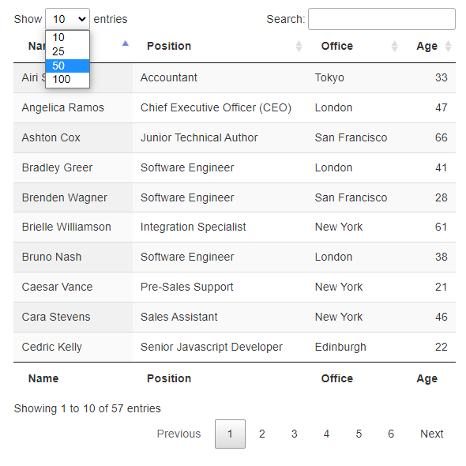
This is what it would have looked like in data tables
Already 3 missing features are present.
We can click on different page numbers.
We can see the total entries we have gone through in the table.
We can choose how many to display at once.
Open source!

Slide 9
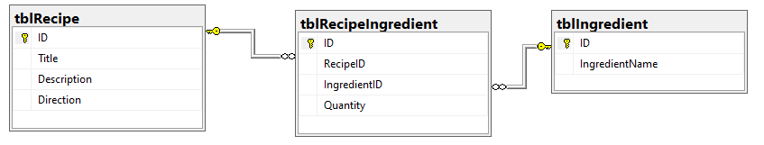
Fire up Visual Studio so we can do all this now.
Install .NET 6 SDK.
Install Visual Studio 2022.
Prerequisites
DataTables allows us do all of this.
Allows us to render the data from many backend databases.
Allows us to render data from joined tables.

Slide 10

Still here? Let's review!
DataTables Editor is amazing especially with CRUD apps.
The server-side libraries are free but just don’t support (ORMs) Object Relational Mappers like Entity Framework Core.
You can reuse my GitHub Project to show in an offline proof-of-concept prototype and convince your company to purchase the client-side libraries down the track if you work for a startup.
Austin Distel @austindistel

Slide 11

Who’s this Jordan bloke anyway?
I used to be a slalom skater.
Became an advocate for undercover multipurpose public areas.
Now I work in customer service full time. It’s really dull but coding and making things on Github sets me free, when it works of course.

